Slide 1


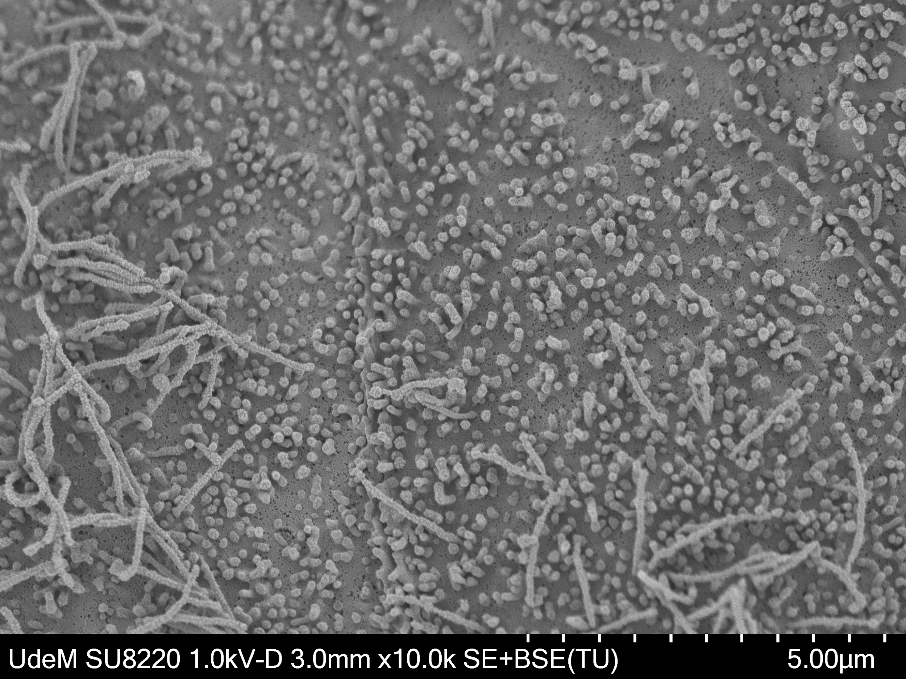
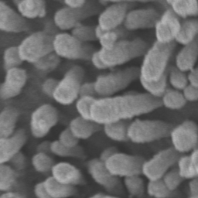
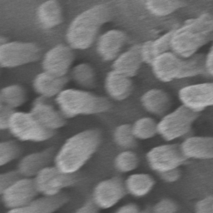
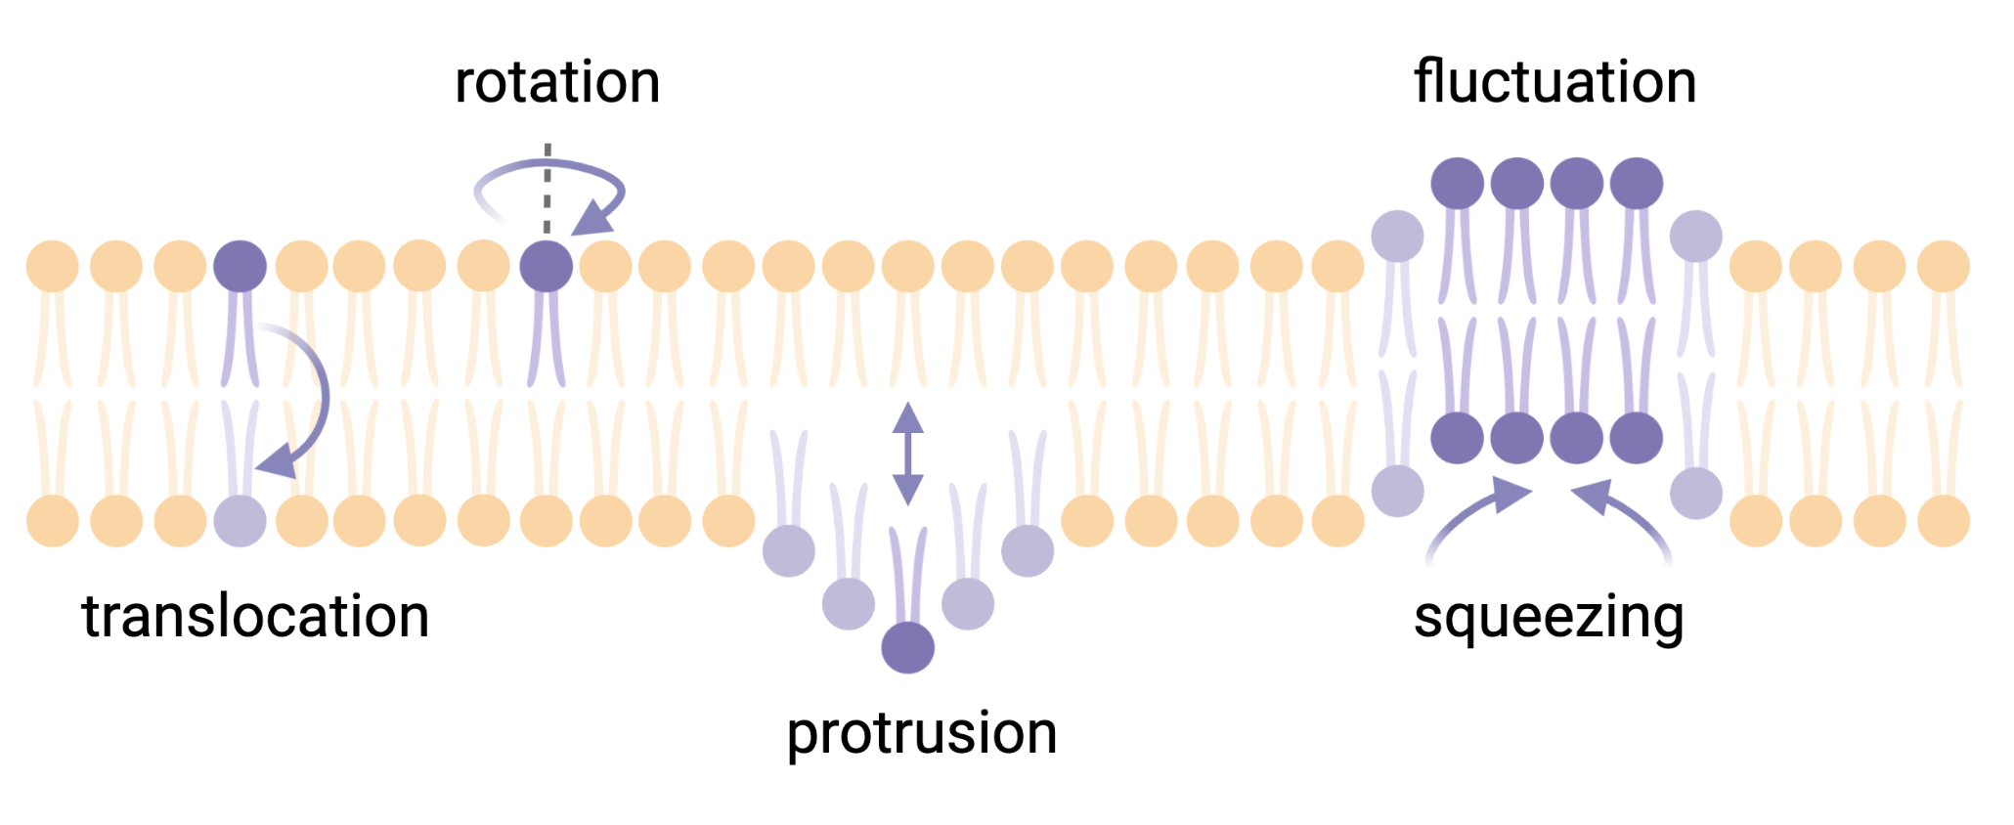
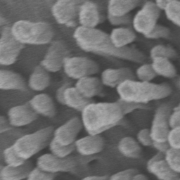
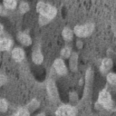

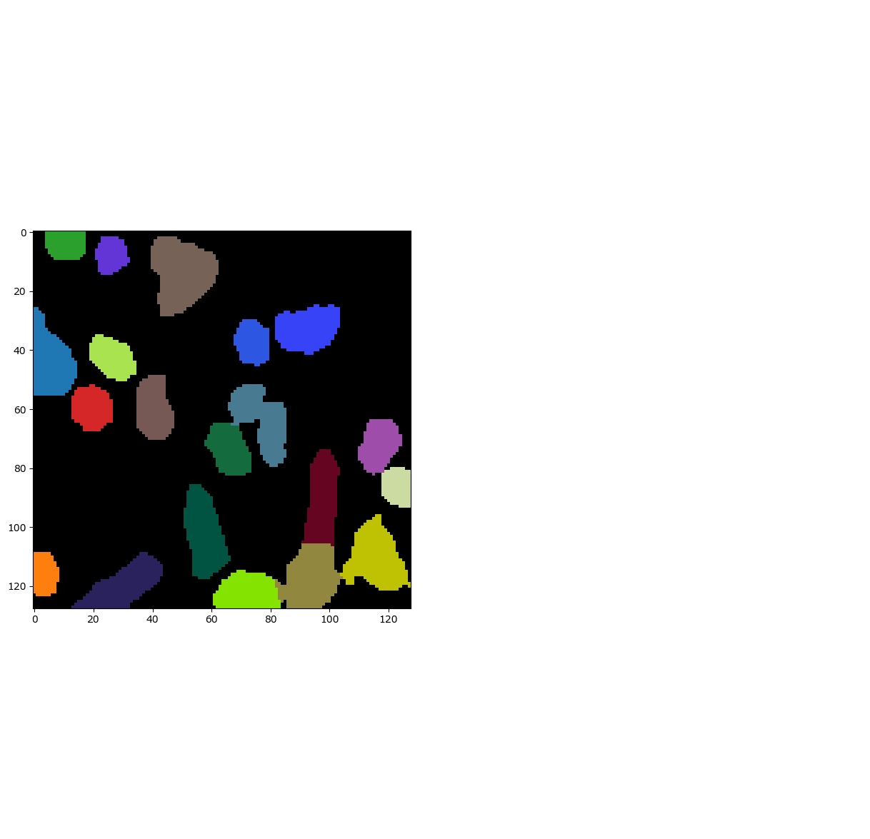
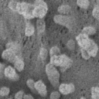

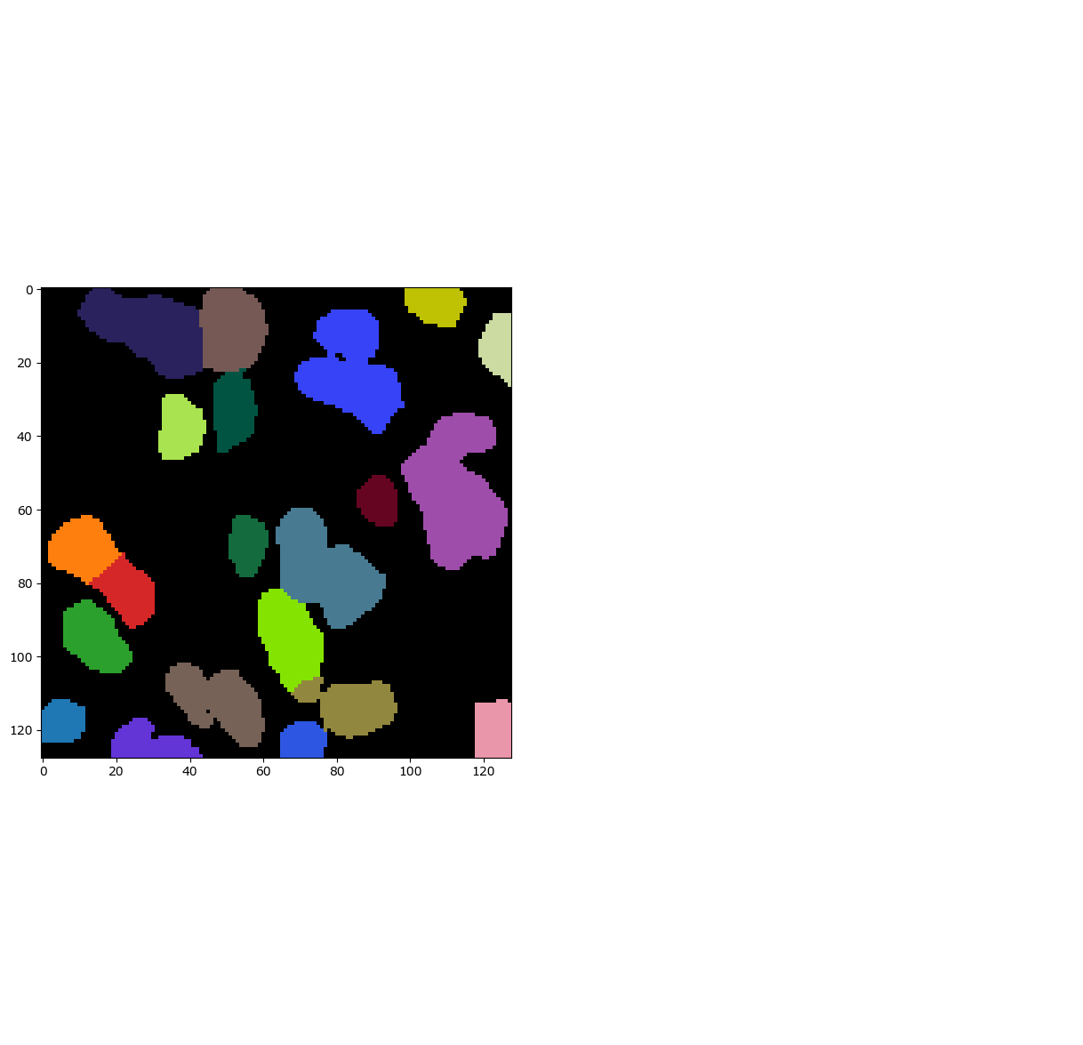
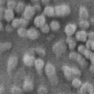

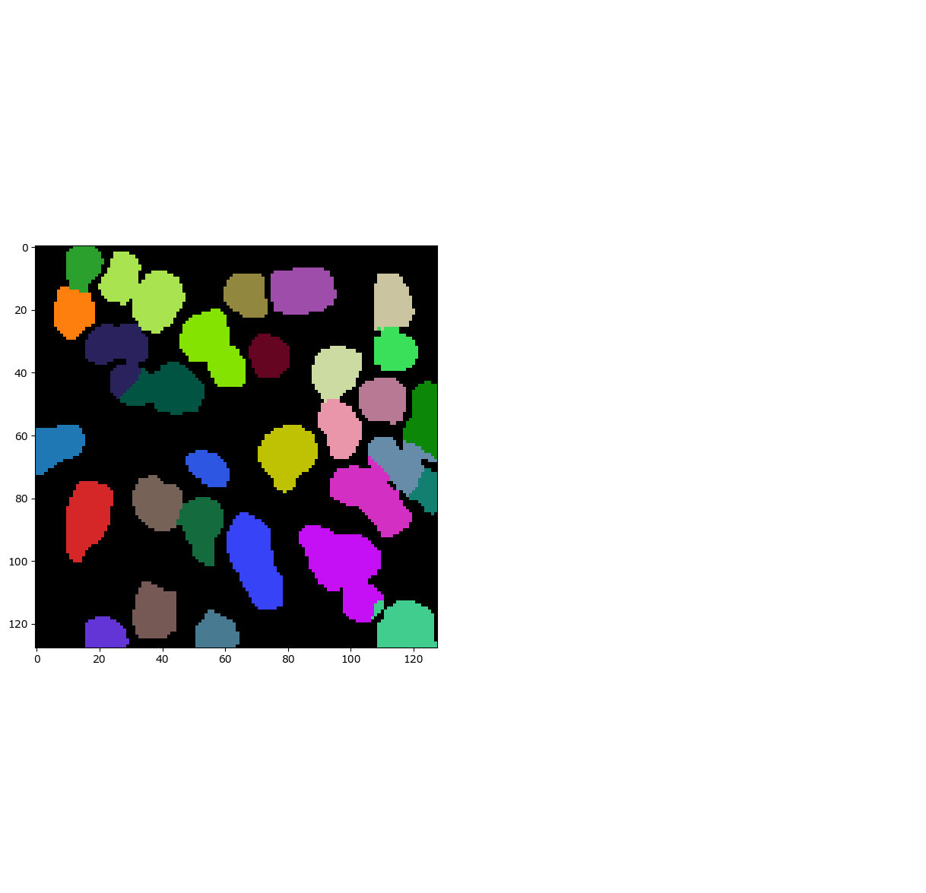



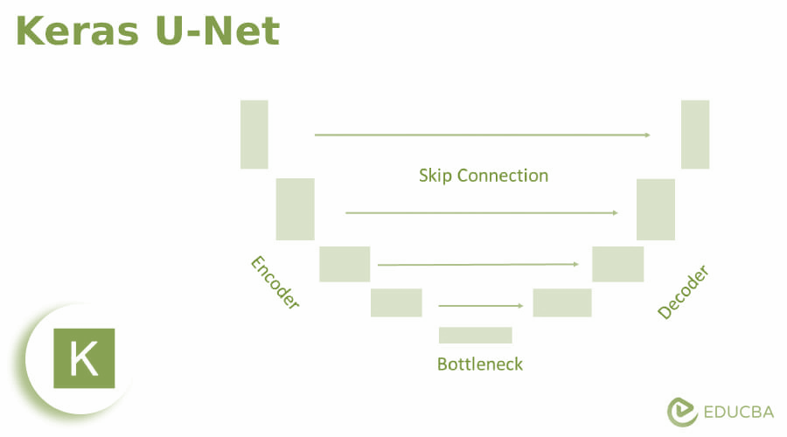
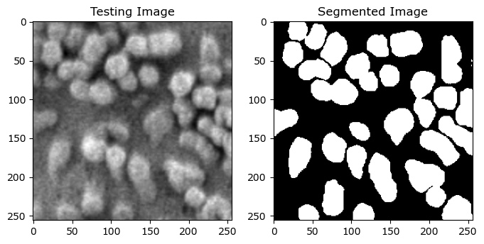
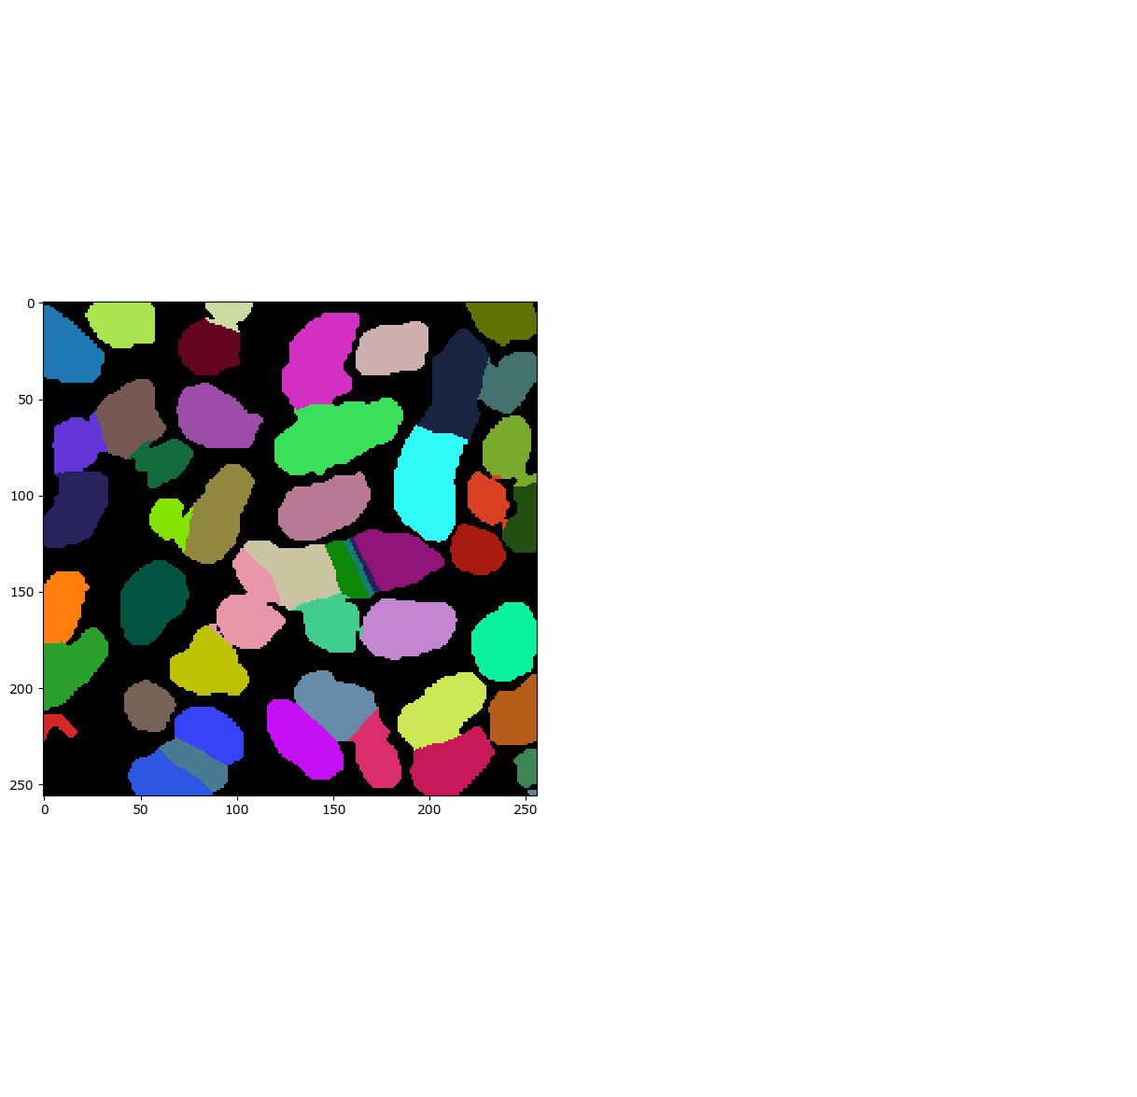
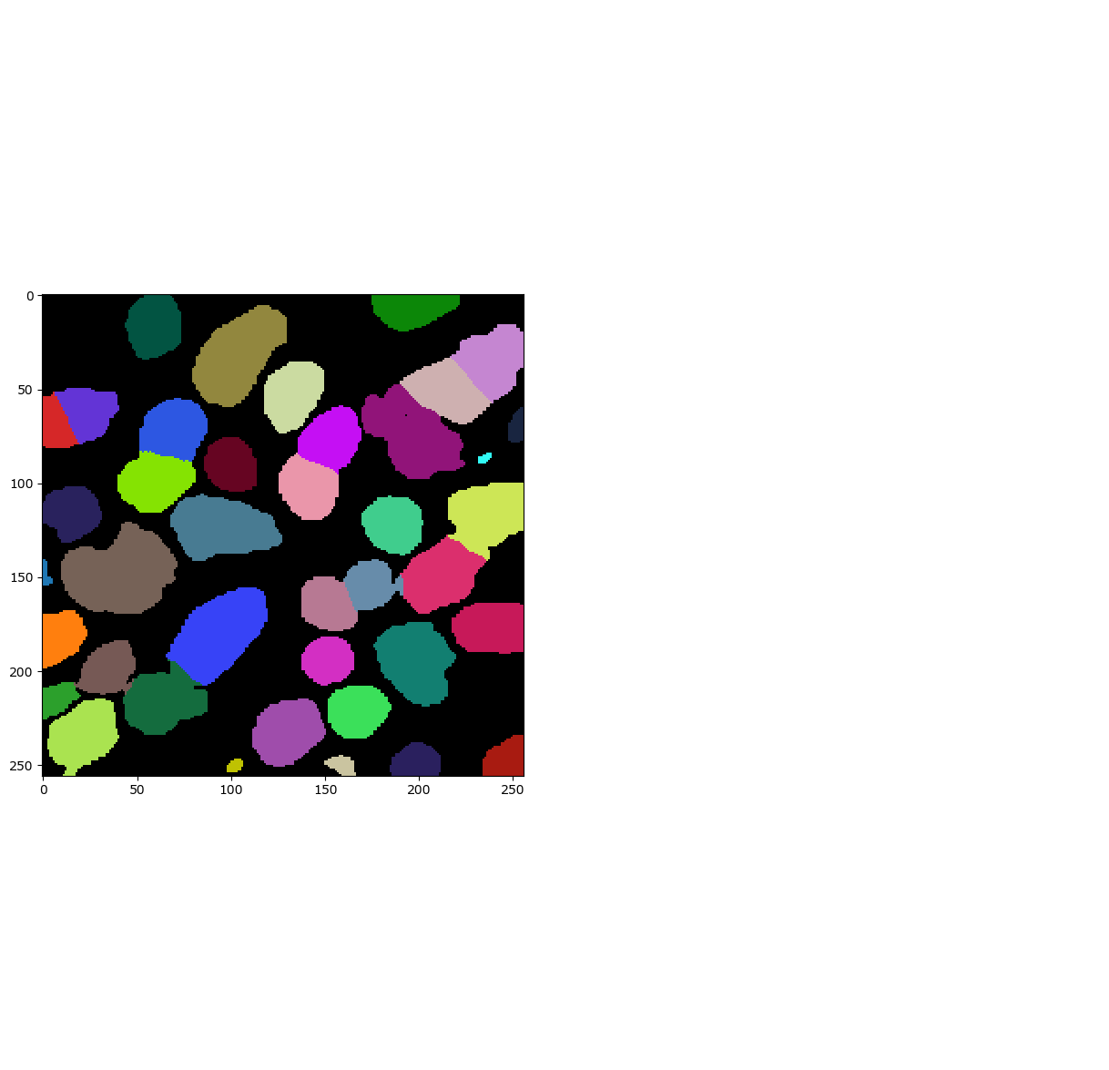
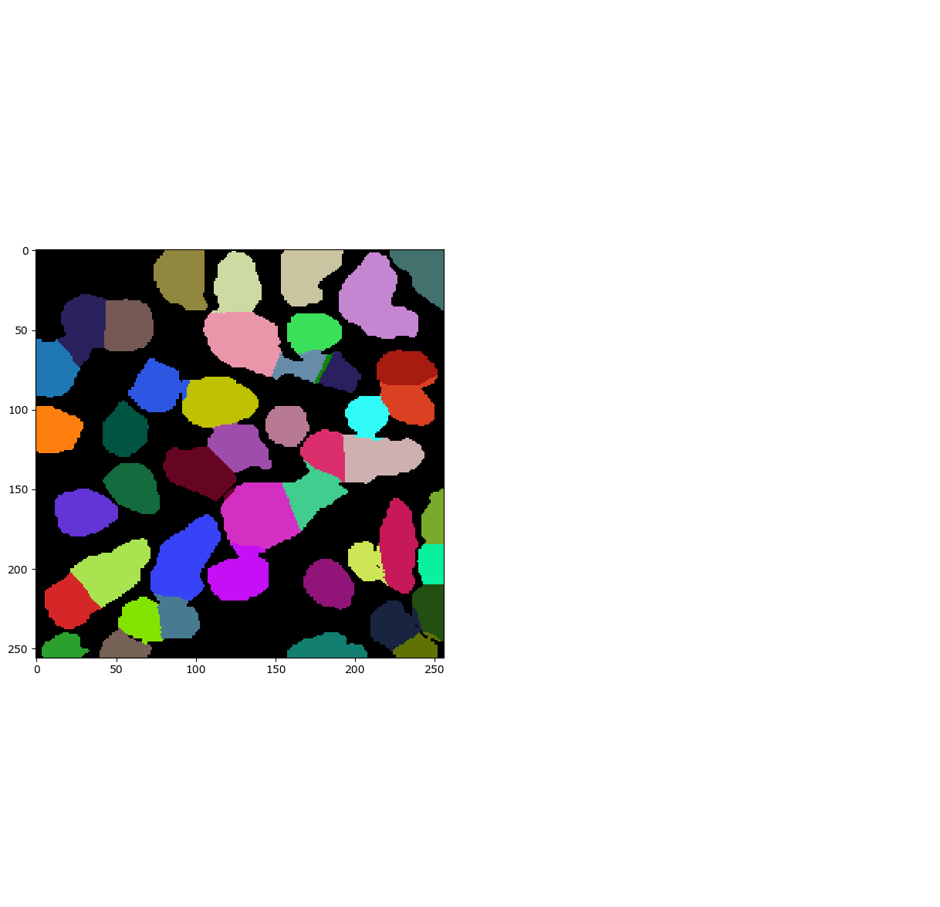
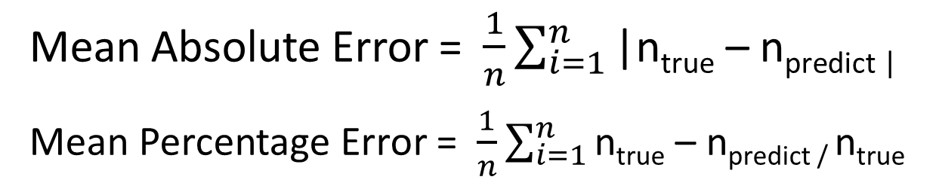
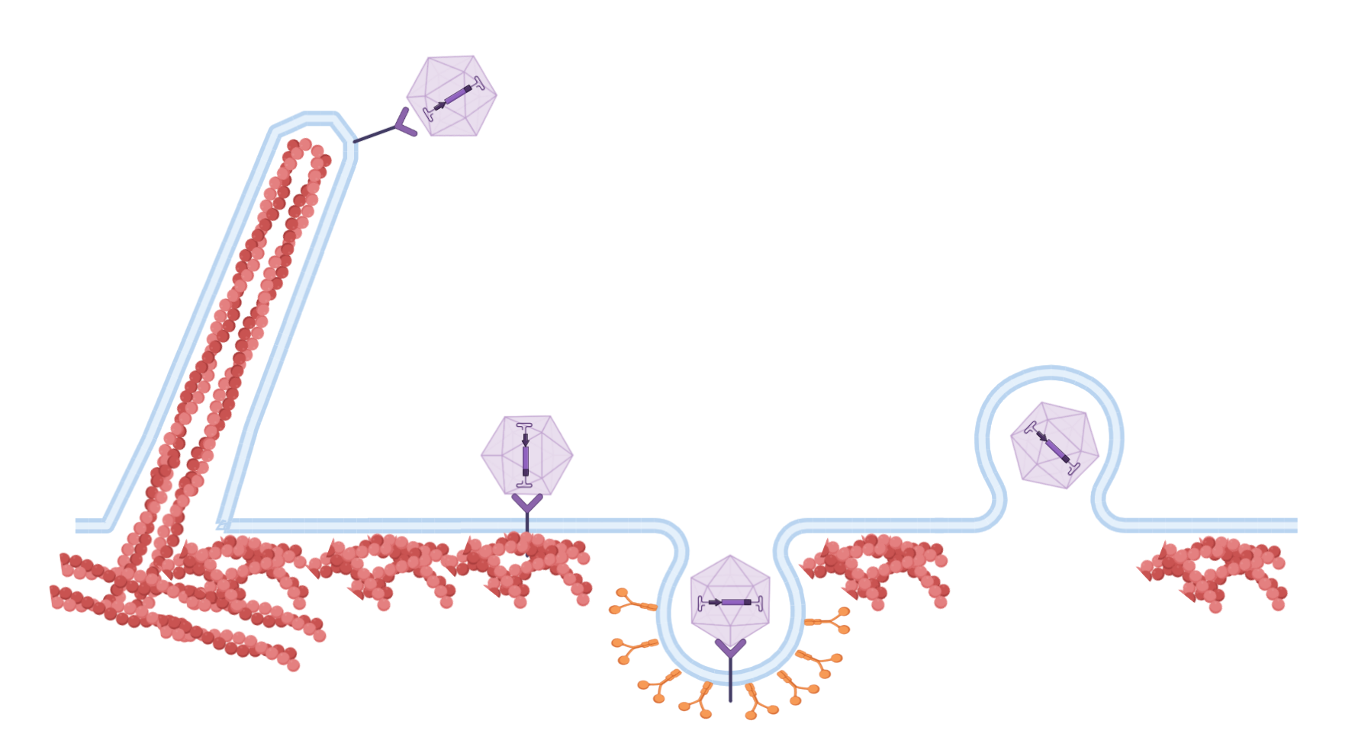


















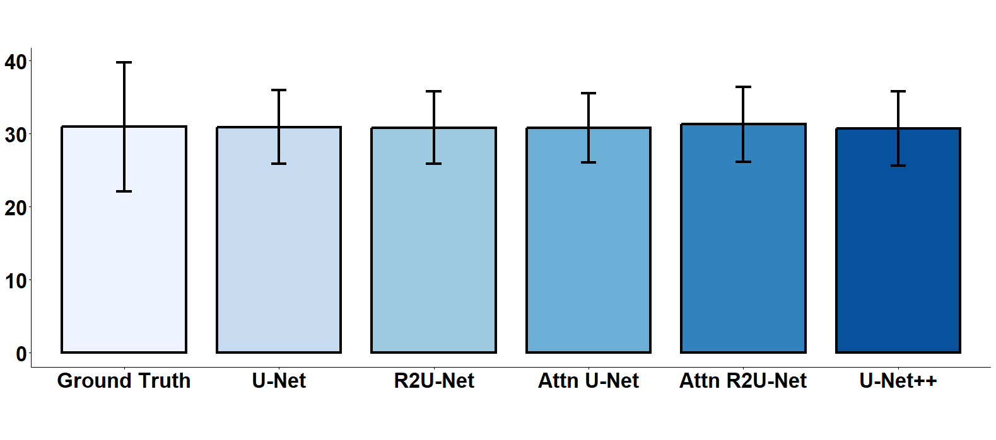





Machine learning quantification of lamellipodia in scanning electron microscopy (SEM) of Madin-Darby Canine Kidney Cells (MDCK)
Lucy Hui¹, Samar Micky², Mohamed Eisa², Angela Pearson², Amadou Barry¹
¹UMR INRS-UQAC en santé durable, Saguenay, Québec, Canada
²Centre Armand-Frappier Santé Biotechnologie, Institut National de la Recherche Scientifique, Laval, Québec, Canada
BACKGROUND
PIPELINE
Membrane dynamics
The dynamic nature of plasma membranes support many biological functions that are vital to cell survival [1].
Variations in environmental factors such as pathogen exposure can alter membrane structures.
Membrane extensions
Recent studies have revealed that viruses exploit membrane dynamics by inducing the formation of membrane protrusions, such as lamellipodia, in order to facilitate its entry, trafficking, and spread in host cells [2].
Quantitative analysis of virus-induced changes in membrane structures represent an important avenue for studying viral pathogenesis and discovering treatment options.
Study motivations
Manual quantification of membrane extensions is time-consuming, inconsistent, and error-prone.
Machine learning and deep learning pipelines for quantifying membrane extensions have not yet been established.
U-Net
State-of-the-art and accessible deep learning model developed for biomedical image segmentation [5].
Data pre-processing
Model training
Model evaluation
Apical surface of polarized MDCK cells grown on inserts [2]
MDCK cells grown as monolayers on tissue culture plates [6]
U-Net
R2U-Net
Attn U-Net
Attn R2U-Net
U-Net++
Detection Metrics
Large View
Semantic Segmentation
Instance Segmentation
Accuracy = (TP + TN) / (TP + FP + FN)
Precision = TP / (TP + FP)
Recall = TP / (TP + FN)
F1 score = 2*TP / (2*TP + FP + FN)
Crop
Resize
Validation Samples
TP = true positive
TN = true negative
Normalize
Training Samples
Otsu binarization
FP = false positive
FN = false negative
Distance transform
Quantification Metrics
Patch Analysis
Watershed algorithm
Downsampling
Upsampling
Lamellipodia quantification
RESULTS
METRICS
Lamellipodia
(a) Viral surfing
Original SEM | Ground Truth | U-Net | R2U-Net | Attn U-Net | Attn R2U-Net | U-Net++
 | Count: 20 | Count: 22 | Count: 21 | Count: 20 | Count: 23 | Count: 18
 | Count: 37 | Count: 32 | Count: 29 | Count: 30 | Count: 29 | Count: 29
 | Count: 41 | Count: 39 | Count: 38 | Count: 40 | Count: 39 | Count: 40
 | Mean Accuracy | Mean Precision | Mean Recall | Mean F1 | MAE | MPE (%)
U-Net | 0.9383 | 0.9162 | 0.9348 | 0.9240 | 5.6 | 22.6
R2U-Net | 0.9379 | 0.9110 | 0.9402 | 0.9238 | 5.2 | 21.5
Attn U-Net | 0.9365 | 0.9182 | 0.9278 | 0.9212 | 5.6 | 22.9
Attn R2U-Net | 0.9379 | 0.9092 | 0.9298 | 0.9238 | 5.3 | 21.7
U-Net++ | 0.9384 | 0.9229 | 0.9279 | 0.9239 | 5.1 | 20.9
Actin monomer
(c) Viral fusion
(b) Endocytosis
Figure 1. Modes of viral entry into host cell [3].
Table 2. Evaluation metrics. U-Net++ surpassed other models on lamellipodia detection and quantification, however this difference is non-significant.
DISCUSSION
OBJECTIVES
We show the ability of U-Net architectures to segment, detect, and quantify lamellipodia from SEM images of MDCK cells.
Average count from all five machine learning methods were comparable to average manual counts, however, counts from machine learning methods consistently had lower variability compared to manual counts.
Automated counting of plasma membrane structures will increase researchers' ability to quantify changes to the plasma membrane ultrastructure in response to different environmental conditions.
Identify and apply diverse machine learning tools for quantifying lamellipodia in scanning electron microscopy (SEM) of MDCK.
Evaluate and compare the performance of machine learning tools on lamellipodia detection and counting ability.
Select and implement the best tools based on lamellipodia detection and counting ability.
Table 1. Quantification of lamellipodia. Every unique color corresponds to one lamellipodia. Counts from machine learning methods (U-Net, R2U-Net, Attn U-Net, Attn R2U-Net, U-Net++) are comparable to manual count (Ground Truth) in three SEM images representing low, moderate, and high density.
Code availability
REFERENCES
Average Count ± SD
ACKNOWLEDGEMENTS
A.C. Woodka, P.D. Butler, L. Porcar, B. Farago and M. Nagao. Lipid bilayers and membrane dynamics: Insight into thickness fluctuations. Physical Review Letters, DOI: 10.1103/PhysRevLett.109.058102, Vol. 9, Issue 5, Aug. 3, 2012.
Eisa M, Micky S, Pearson A. Canid herpesvirus 1 Preferentially Infects Polarized Madin-Darby Canine Kidney Cells from the Basolateral Surface. Viruses. 2022 Jun 14;14(6):1291.
Taylor, M., Koyuncu, O. & Enquist, L. Subversion of the actin cytoskeleton during viral infection. Nat Rev Microbiol 9, 427–439 (2011).
Faustino, G. M., Gattass, M., Rehen, S. & de Lucena, C. J. P. Automatic embryonic stem cells detection and counting method in fluorescence microscopy images. In 2009 IEEE International Symposium on Biomedical Imaging: From Nano to Macro, 799–802.
N. Siddique, S. Paheding, C. P. Elkin and V. Devabhaktuni, "U-Net and Its Variants for Medical Image Segmentation: A Review of Theory and Applications," in IEEE Access, vol. 9, pp. 82031-82057, 2021.
Eisa, Mohamed, et al. “Entry of the Varicellovirus Canid Herpesvirus 1 into Madin–Darby Canine Kidney Epithelial Cells Is PH-Independent and Occurs via a Macropinocytosis-like Mechanism but without Increase in Fluid Uptake.” Cellular Microbiology, vol. 23, no. 12, 2021, p. e13398.
INRS Centre Armand-Frappier Santé Biotechnologie Electron Microscopy Service
lucy-mhui

